Slide 1

Distracted Driver Detection
By
Group - 8

Slide 2


INDEX
Shyam Prasad Immadi
2. Praneeth Varma D B R S
3. Phani Chyavan DSK

Slide 3
Background
Most car accident litigation revolves around claims of negligence. That is, the defendant driver is not accused of intentionally causing the accident, but is accused of making errors or omissions in driving conduct that created an undue danger of an accidental collision.
And most of the accidents are caused due to driver error. So, we have decided to do a project that is propounded to the solution for detection of distractions by drivers.

Slide 4
Problem definition
One in five car accidents is caused by a distracted driver. Sadly, this translates to 425,000 people injured and 3,000 people killed by distracted driving every year.
State Farm hopes to improve these alarming statistics, and better ensure their customers, by testing whether dashboard cameras can automatically detect drivers engaging in distracting behaviors.
We are given a moderate-sized data set from which we need to classify our driver images into different classes. These classes are nothing but driver activities.

Slide 5
Contributions(novelty)
we have looked for different notebooks for the reference of our project but we found none on mobile net and FFN.
And using PyTorch is limited for this approach.
we managed to tweak weights good and our model learned with a loss of 0.021 and an accuracy of 98%

Slide 6
Solution approach
Data collection and augmentation:
we have accumulated our information from Kaggle and played out certain argumentations like resizing, normalizing, changing over to tensors, clumping pictures.
choosing model :(we have chosen the mobile net version of CNN)
MobileNet utilizes both depthwise and pointwise divisible convolutions. It fundamentally decreases the number of boundaries when contrasted with the organization with standard convolutions with similar profundity in the nets. These outcomes in lightweight profound neural organizations.
This type of network is made from two operations.
1. Depthwise convolution, 2. Pointwise convolution.

Slide 7
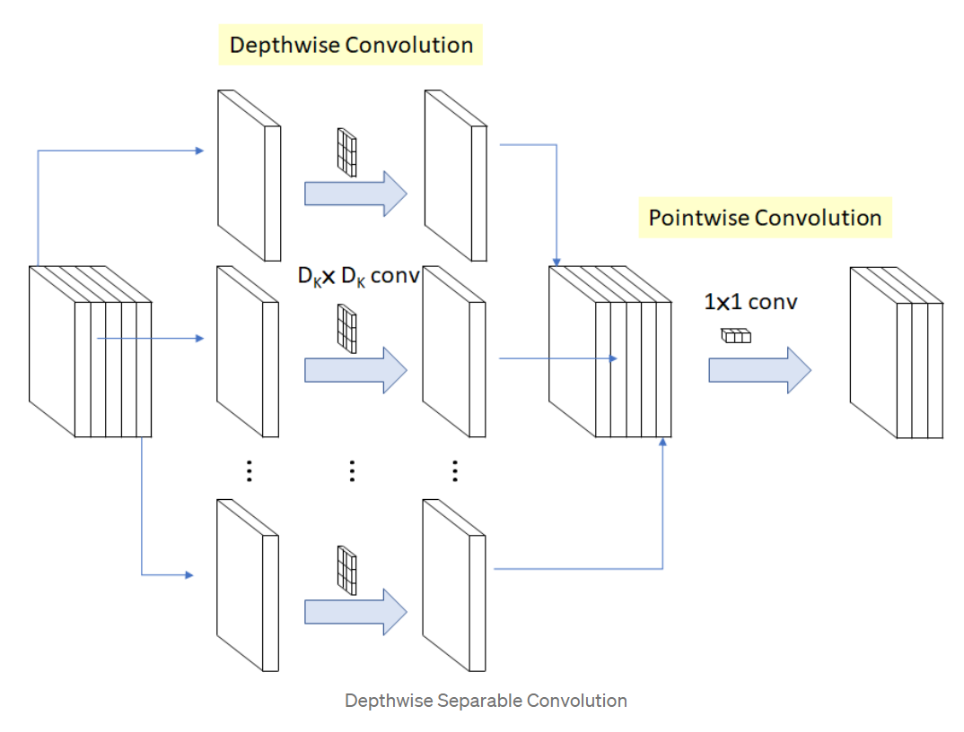

Slide 8
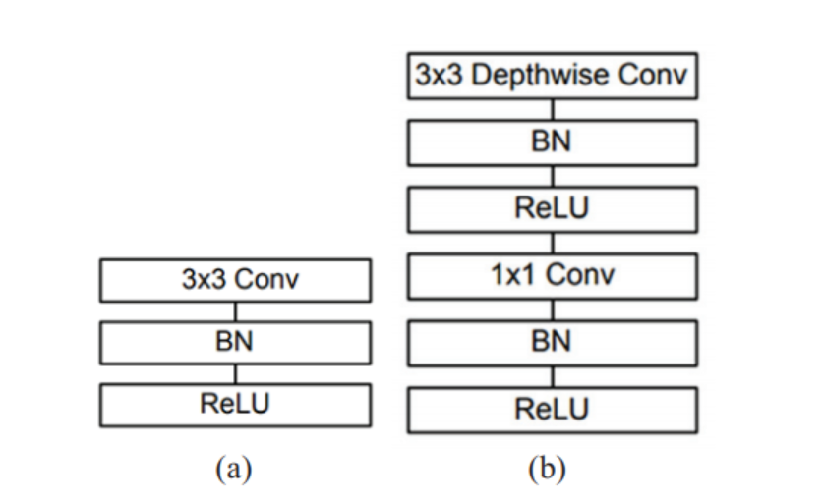
MobileNet model has 27 Convolutions layers which include (fig3.a) 1 normal convolution,(fig3.b) 13 depthwise Convolution and 13 pointwise convolutions, 1 Average Pool layer, 1 Fully Connected layer, and 1 Softmax Layer.
95 percent of the time is spent in 1x1 Convolution in MobileNet.

Slide 9
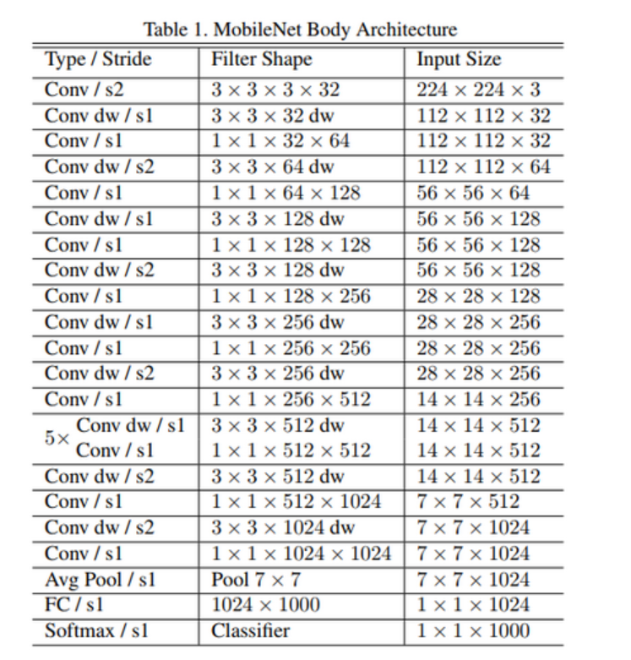

Slide 10
Feedforward neural network:
Initially, we also tried with Feedforward neural network, we took one input layer having nodes 80*80*3 and 3 hidden layers 100,100,60 respectively. And an output layer of 10 with softmax.
hyperparameter tunning:
Each node in the hidden layer has relu as an activation function outputting activation score 0 to 1. And to solve the vanishing gradient we used Adam optimizer with a learning rate of 0.001.
we have used cross-entropy to caliculate loss and recorded a loss of 0.010 for 3 epochs and an accuracy of 97.
for each of the models, we performed train, validation, test to make our model better.

Slide 11
Dataset
State Farm is a large group of insurance and financial-vices companies throughout the United States. They released their dataset of 2D dashboard camera images for a Kaggle challenge. The dataset had 22400 training images and 79727 testing images. The resolution was 640 x 480 pixels. The training images had corresponding labels attached. Labels be-longed to one of the ten classes as mentioned below:
•c0: normal driving
•c1: texting - right
•c2: talking on the phone - right
•c3: texting - left
•c4: talking on the phone - left
•c5: operating the radio
•c6: drinking
•c7: reaching behind
•c8: hair and makeup
•c9: talking to the passenger

Slide 12
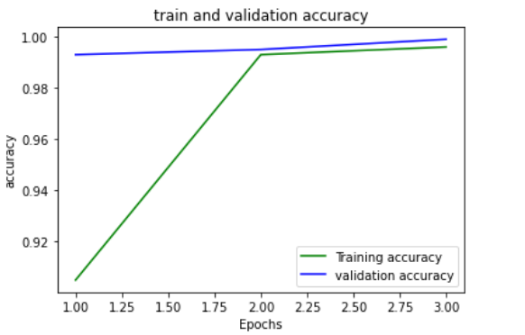
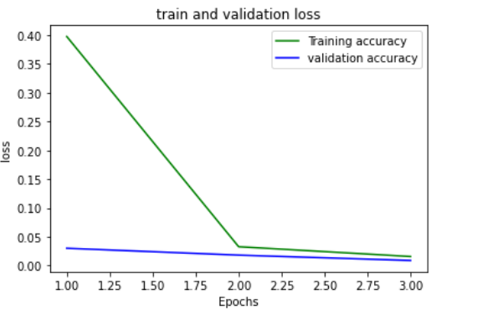
Experimental results
These are the train and validation accuracies and losses for 3 epochs. We can say that our model has performed well. By having a loss of 0.021 and at the testing we got an accuracy of 98%.

Slide 13
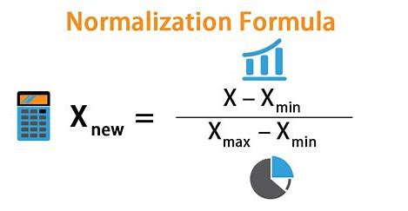
Hyper parameter tunings
we have used SGD, Adam optimizer for the gradient descent to solve the vanishing gradient and add momentum. Both have worked well.
we have used relu as activation function outputs in range 0 - 1 as activation.
And additionally, we have batched our signals (images) of size 10, resized images into (224,224), and normalized our images.

Slide 14
Comparison with existing
We have also Alex net along with a mobile net and found that mobile net is computationally less effective having parameters 60M and 4.2M respectively. whereas google net, VGG has 6.8M and 138M.
we have got an accuracy of 93.7% with a loss of 0.192 for Alex net and an accuracy of 98% with a loss of 0.021

Slide 15
Related work and Reference
This is an open competition on Kaggle conducted by a state farm an American insurance company. Many have worked on this, but a few have used mobile net and PyTorch
which gave good results for our project.
references:
Detection of Distracted Driver Using Convolutional Neural Network (thecvf.com)
[1704.04861] MobileNets: Efficient Convolutional Neural Networks for Mobile Vision Applications (arxiv.org)

Slide 16
Thank You

